Slide 1
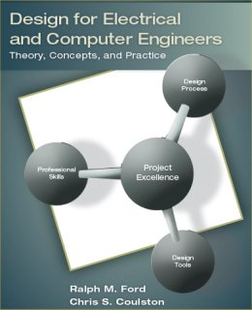
Project Selection and Needs Identification Chapter 2 in Text

Slide 2
Learning Objectives
By the end of this section, you should:
Have an understanding of the types of projects electrical and computer engineers undertake.
Understand and be able to apply sound criteria for project selection.
Know how to determine, document, and rank end-user needs.
Be aware of resources for conducting research surveys.
Have selected a project concept and developed a problem statement.

Slide 3
Design Projects Types
Creative
New and innovative design
Ipod, iphone, i*
Variant
Variation of existing design
Improve performance
Add more features
Routine
Theory & practice well understood (i.e. DC Power supply design)
Part of more complex creative or variant designs

Slide 4
Engineering Design Projects Types
Systems Engineering & Integration
Synthesis of many smaller systems into one larger-scale system
May be creative or variant
Challenges due to involvement of many people and technologies
Systems Testing
Does system meet requirements and needs of user?
Performance profile validation
Experimental Design
Design experiment or apparatus
Find system characteristics
Analysis
Improvement of an aspect or correction of a problem
Find failure modes or determine failure probabilities

Slide 5
Types of Engineering (Research) Projects
Discover or create something new.
Technology evaluation
Applied Research
Fundamental Research

Slide 6
Sources of Project Ideas
Industry or business sponsorship
Campus and local community
Faculty
Brainstorming
You!
Professional contacts or organization
Engineers without Borders

Slide 7
Project Feasibility & Selection Questions to answer up front!
What are you trying to do? Articulate your goals using absolutely no jargon.
How is it done today, and what are the limitations of current practice?
What is new in your approach, and why do you think it will be successful?
Who cares? If you are successful, what difference will it make?
What are the risks and payoffs?
How much will it cost? How long will it take?
What are the benchmarks to check for success?

Slide 8
Project Selection Criteria Another Perspective
Project must
Be tied to the mission and vision of the organization
Must have payback – economic analysis should suggest “profit”
Be selected as a result of application of sound criteria among competing projects
Objectives must be SMART
Specific, Measurable, Assignable, Realistic, and Time related.

Slide 9
Project Selection Criteria Motivation
Decision making is a hallmark of design.
Often faced with multiple alternatives and criteria against which decision must be made.
Analytical Hierarchy Process (AHP) is a well-known an intuitive method.

Slide 10
Project Selection Criteria Use of Analytical Hierarchy Process
Determine selection criteria
Your interest, technical complexity, creativity, innovation, marketing potential, etc.
Determine the criteria weightings
Identify and rate alternatives relative to criteria
Compute scores
Review the decision

Slide 11
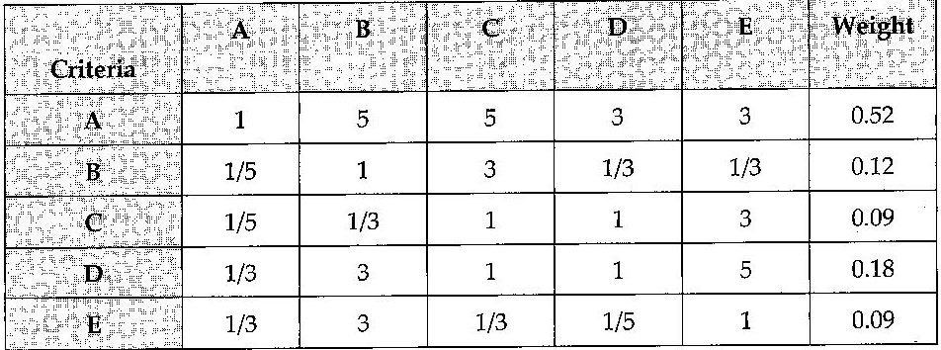
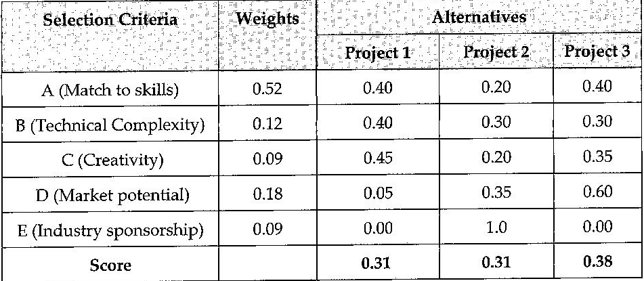
Project Selection Criteria Creating the AHP Model
Selection Criteria:
A: Match to team skills
B: Technical complexity
C: Creativity
D: Market potential
E: Industry sponsorship

Slide 12
AHP – Resources
See Appendix B – Complete description of AHP
Watch a Video Intro http://www.youtube.com/watch?v=18GWVtVAAzs
Review the Tutorial posted with course website

Slide 13
Needs Identification
Customer statements for a new process, product or service may not be what exactly an engineer requires!
Customers may state the problem and a particular solution bias packaged together
This will constrain the design space unnecessarily.
An engineer needs to tactfully challenge the assumptions and ask questions to get the root of the problem.
Asking clarifying questions, analysis, picking apart the requests, and focus on the problem (not the solution) are essential.

Slide 14
Needs Identification
Eliciting needs from the customer is a prerequisite to developing good engineering specs.
Process to obtain customer input:
Gather raw data.
Translate to marketing requirements.
Organize the needs into a hierarchy.
Rank the Needs
Review the outcomes and the process

Slide 15
Process to obtain customer input
Gather raw data from users
What are the pros and cons of the existing process
Understand the process and problem
Interpret the raw data in terms of needs (Need)
What is the customer requirement (marketing specification)
Not quantified – they use terms such as: good, easy, user friendly, etc.
Design an audio device that is portable, easy to use with high quality. (extension) It should be water resistance, long lasting, small and drop resistance.
Quantify the needs (Tree)
Establish an objective tree
Ranking the relative importance of each specification
Understand the background and existing solutions (Survey)
Use all available resources: Internet, Technical repositories, Journals, Government statistics, etc.

Slide 17
Step 1 – Gather Raw Data
Some methods are:
Interviews (see questions in the book).
Focus Groups
Direct observation
See questions in book
Trends

Slide 18
Step 2 – Translate Needs to Marketing Requirements
Marketing Requirements
Statement of Customer Needs in language of customer.
What the product should do, NOT how it should be achieved.
Short, action-oriented phrases
Example - “The system should have high quality audio.”

Slide 19
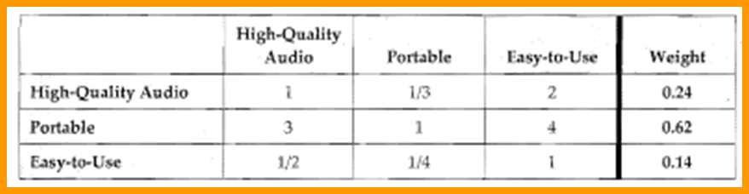
Step 3 – Organize Needs to Marketing Hierarchy
Organize needs by functional similarity, not by importance!

Slide 20
Step 4 – Rank the Needs
Rank the needs to determine the relative importance of each of the needs.
Systematically compare each need to all other needs.
Tool: pairwise comparison matrix.

Slide 21
Step 5 – Review the Outcomes and the Process
Process
This is just a process that embodies a good practice.
It is ultimately for making decisions about what is important to the end-user.
In the end ask yourself – “Does this make sense?”
If not, you should make it so that it does or determine why not.
Outcomes
Marketing requirements that identify needs
An objective tree
A ranking of the relative importance of needs

Slide 22
Research Survey
You need to become the experts on the problem and state-of-the-art in this area.
If you don’t, then you
re-invent the wheel
don’t look too smart

Slide 23
Research Survey Objective
Finding out answers to following questions is important:
What is the basic theory behind the concept?
How is it currently being done?
What are the limitations of the current designs or technology?
What are the similarities/differences between your concept and current systems?
Are there existing or patented systems that are relevant to the design?

Slide 24
Research Survey Resources
See pp. 28-30 in your text for details:
Internet resources
Electrical and computer engineering resources
Government resources
Professional and trade magazines or periodicals
Journal and conference papers.

Slide 25
Research Survey Electrical and Computer Engineering Resources
EE Product Center, www.EEProductCenter.com
Circuit Cellar, www.CircuitCellar.com.
Datasheet Catalog, www.DatasheetCatalog.com
EE Times, wLuw.EETimes.com.
Electronic Magazine, wwro.EDNmag.com
ON Semiconductor, www.OnSemi.com.
The Thomas Register, www.ThomasRegister.com

Slide 26
Problem Statement
A problem statement has the following parts:
Needs statement
Identifies and motivates the need for the project.
Objectives statement
Background (through Research Survey)
Marketing Requirements
Objective Tree

Slide 27
Needs Statement
The needs statement should
briefly and clearly state the need to be met
not provide a solution to the problem
provide supporting statistics or anecdotes
describe current limitations
describe any supporting processes.

Slide 28
Needs Statement Example
According to AppleInsider, approximately 10.3 million people owned iPods at the end of 2004 and many of the owners used them while operating their automobiles. The National Highway Traffic Safety Administration estimates that driver distraction is a contributing cause of 20 to 30 percent of all motor vehicle crashes – or 1.2 million accidents per year. One research study has estimated that driver inattention may cause as many as 10,000 deaths each year and approximately $40 billion in damages. iPods can present a distraction to drivers that is similar to cell phones in that the driver’s attention is divided between controlling the steering wheel, watching the road, and navigating controls on the iPod. A system is needed to allow users to navigate among the music selections of their iPod without distracting their attention from the road.
From the iPod Hands-Free Device Design Report by Al-Busaidi, Bellavia, and Roseborough [Alb07].
The needs statement should
briefly and clearly state the need to be met
not provide a solution to the problem
provide supporting statistics or anecdotes
describe current limitations
describe any supporting processes.

Slide 29
Objective Statement
The objective statement should
Summarize what is being proposed to meet the need
Provide some preliminary design objectives
Provide a preliminary description of the technical solution, avoiding a detailed description of the implementation.

Slide 30
Objective Statement Example
The objective of this project is to design and prototype a device that will make the iPod safer to use while driving an automobile, by allowing hands-free control of the iPod. The device will interact with the user using spoken English commands. The user will be able to issue simple voice commands to the device to control the operation of the iPod. In turn, the device will communicate information verbally, such as song titles that are displayed on the iPod screen, to the user.
From the iPod Hands-Free Device Design Report by Al-Busaidi, Bellavia, and Roseborough [Alb07].
The objective statement should
Summarize what is being proposed to meet the need
Provide some preliminary design objectives
Provide a preliminary description of the technical solution, avoiding a detailed description of the implementation.
Often input-output behavior statement will suffice

Slide 31
Summary
Apply sound project selection criteria.
Determine the true user needs.
Outcomes of the needs elicitation process.
Marketing requirements
Objective Tree
Ranking of the needs
Conduct research survey
Problem Statement
Needs
Objectives

